Slide 1
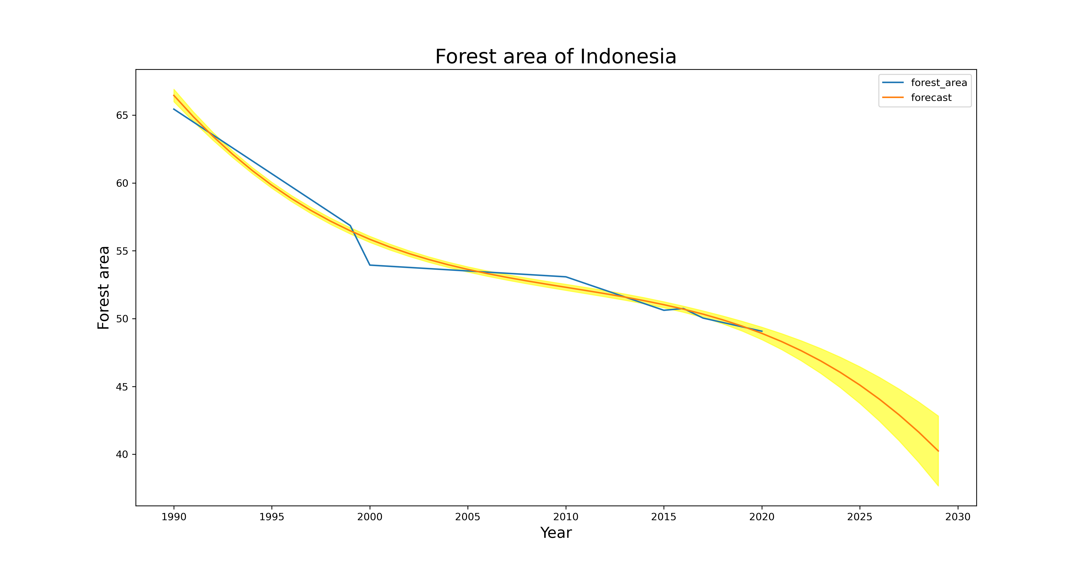
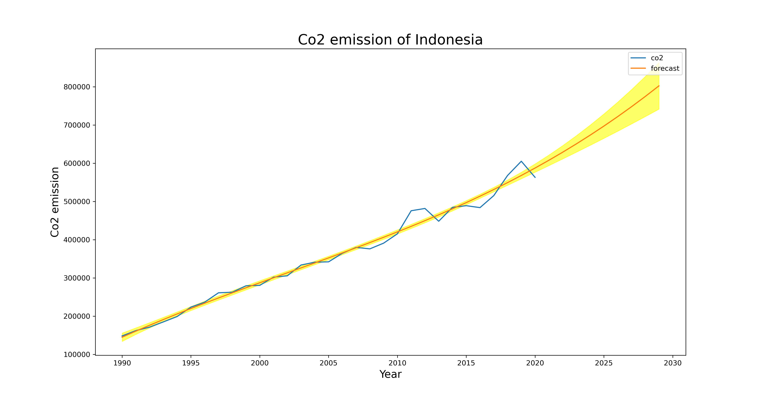
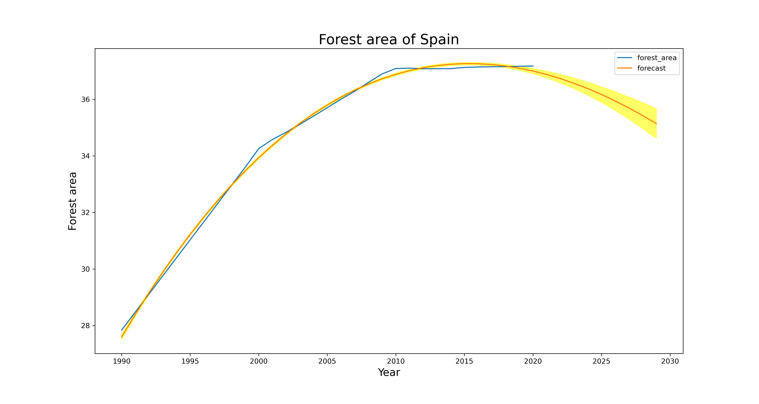
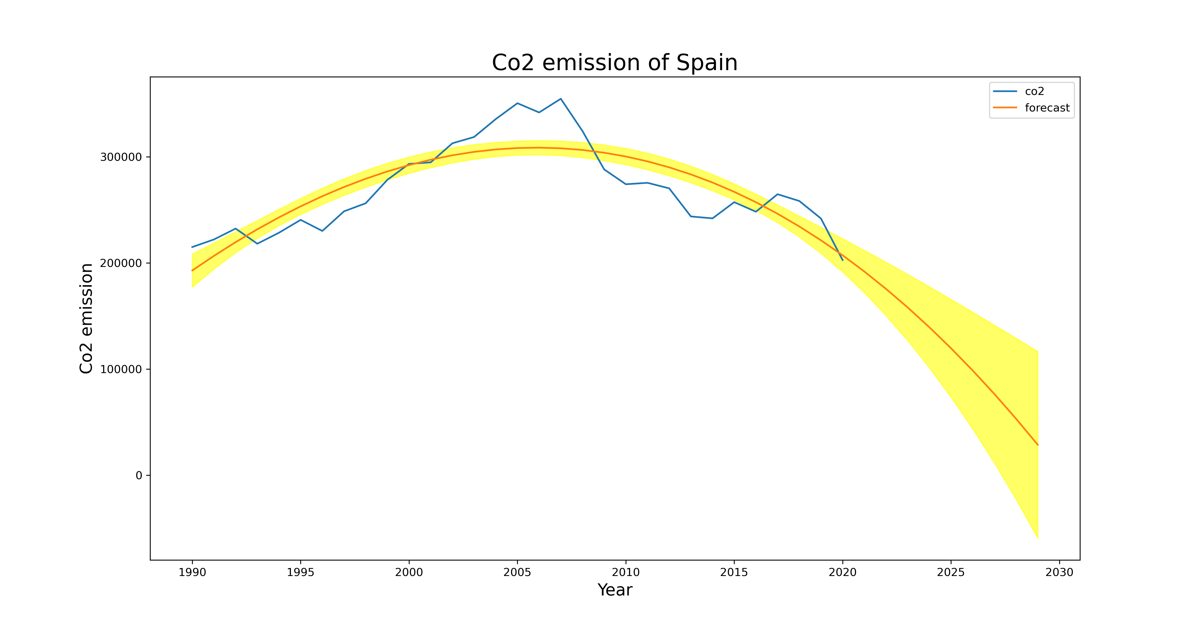
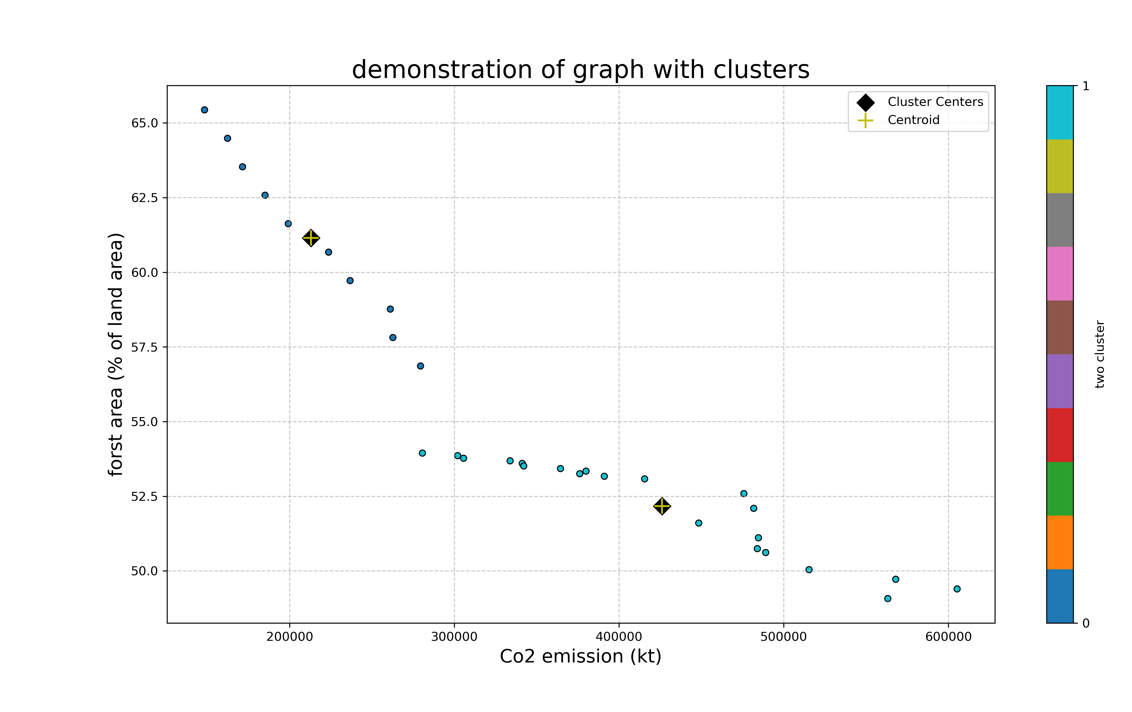
Mitigating Climate Change: The Role of Forests in CO2 Balance
ABSTRACT
The connection between CO2 levels and forests is crucial. When trees are cut down (deforestation), it contributes to higher CO2 levels, worsening the greenhouse effect and climate change. On the flip side, planting trees (forestation) helps absorb CO2, acting like a sponge and reducing emissions. To tackle climate change and keep our environment in balance, it's vital to increase and protect forested areas through planting more trees.
INtroduction
Understanding environmental and forest-related issues starts with using indicators, which are like signs or signals that tell us what's happening in the real world. Two important indicators in this context are "forest area" and "CO2 emissions." These indicators give us clear information about whether forests are growing (forestation) or shrinking (deforestation), and what impact these activities have on the environment. To explain this, I compared the changes in forest area and CO2 emissions from one year to the next. I organized the data by grouping similar patterns, a bit like putting things that are alike together. This helps us see trends more clearly. Finally, I also made predictions about what might happen in the future based on the patterns we observed.
ANALYSIS OF CLUSTERED DATA AND PREDICTION:
From 1990 to 2020, we looked at the information we collected. In France, the amount of CO2 released into the air is going down each year, and every five years, the forest area is getting bigger. These changes directly affect the amount of CO2 released. It seems like people in France care about trees—they plant and grow more of them every year. Now, let's talk about Indonesia. It's a different story there. Because of cutting down trees (deforestation) and not many people knowing about saving trees, Indonesia let out a lot of CO2 into the air throughout the years. I also tried to guess what might happen in the next ten years. I made predictions about how much forest area there will be and how much CO2 will be released in the future.
Conclusion
we've found that the size of the forest directly influences whether forests are being cut down (deforestation) or grown (forestation). By using data analysis to predict future trends, we can estimate a country's forest size, efforts to protect forests, and developments in agriculture. This helps us make informed decisions about the environment and sustainable practices.
Name : Bhavinkumar Subhashbhai harkhani
Student id : 22079315
Repolink: https://github.com/BsHarkhani/ADS-1-ASS.3

